Slide 1

Web based Face Authentication
“Enhancing User Authentication
and Security"

Slide 2
CONTENT
Introduction
Importance & Project objective
Project Scope
Screen shots of implemented work
Demonstration of the Project
Conclusion
References

Slide 3
Introduction
Welcome to the "Web based Face Authentication " project, a venture into the realm of real-time computer vision using OpenCV. As we navigate through the capabilities of OpenCV and webcam integration, our primary focus is to enhance user authentication and security in video call scenarios. This project holds immense potential for various applications, including virtual meetings, online exams, police force operations, and the ever-popular face unlock feature on smartphones.

Slide 4
Importance & Project objective
Importance: In an era where virtual interactions have become integral to daily life, ensuring secure and authenticated access is paramount. This project addresses the demand for reliable user authentication in video calls, offering a versatile solution with applications ranging from professional meetings to law enforcement operations.
Project Objectives: Our objectives are clear: harness the power of OpenCV to detect faces in real-time video calls. By doing so, we aim to create a seamless and secure user authentication experience, contributing to the evolving landscape of technology applications in diverse sectors.

Slide 5
Project Scope
The project's scope extends beyond the immediate implementation, offering a foundation for secure user authentication in various real-time applications. The reach includes but is not limited to:
Virtual Meetings
Online Exams and Assessments
Law Enforcement Applications
Smartphone Security Features
By achieving these objectives, our project aspires to make a significant contribution to the fields of computer vision, cybersecurity, and user authentication in the digital era.

Slide 6
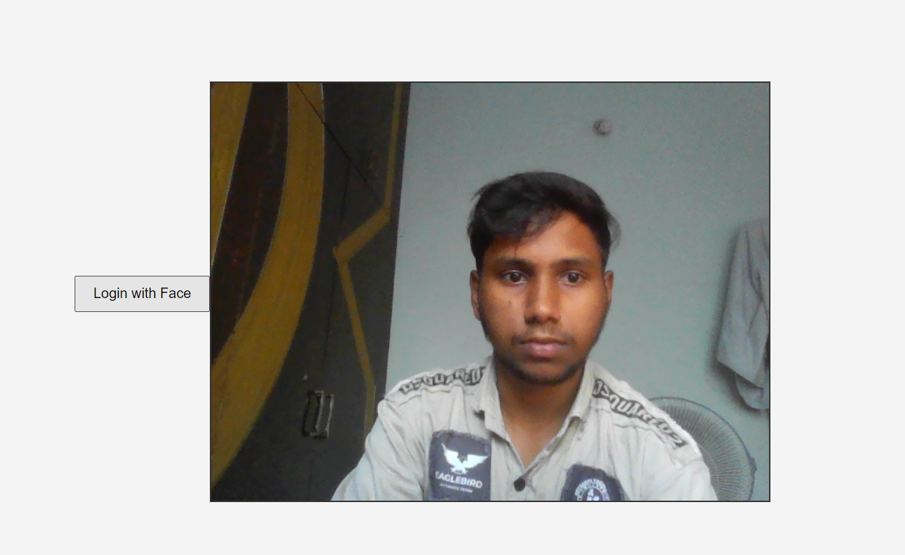

Screen shots of implemented work

Slide 7
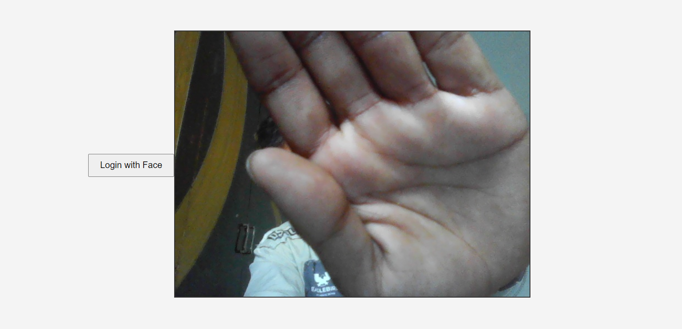


Slide 8
Conclusion
In conclusion, the "Web Face Detector for Video Calls" project represents a successful integration of real-time computer vision using OpenCV to enhance user authentication and security in video call scenarios. By achieving the objectives of implementing a robust face detection system and seamlessly integrating it with webcams, the project establishes a versatile solution with applications ranging from virtual meetings to smartphone security. The successful demonstration of the face detector in action underlines its potential impact on various real-time applications. Looking ahead, the project not only fulfills its immediate goals but also sets the stage for future enhancements, including the integration of advanced facial recognition algorithms and a continuous commitment to addressing security and privacy considerations. This project contributes to the ever-evolving landscape of technology applications, offering a secure and efficient solution for user authentication in the digital age.

Slide 9
References
OpenCV Documentation:
Website: OpenCV Documentation
Reference: OpenCV documentation was invaluable for understanding and implementing real-time face detection using its computer vision libraries.
Books:
Title: "Cryptography and Network Security: Principles and Practice"
Authors: William Stallings
Reference: Stallings' book provided a solid foundation for understanding cryptographic principles, which are essential for secure user authentication.
Title: "Python Crash Course"
Author: Eric Matthes
Reference: Matthes' book served as a valuable resource for Python programming, aiding in the implementation of the project.
Academic Papers:
Title: "A Survey of Image Encryption Techniques"
Author: Shorok A. Ali
Reference: Ali's survey paper offered insights into various image encryption techniques, guiding the implementation of secure image transmission.
Title: "Image Integrity Verification Using Digital Watermarking and Deep Learning"
Authors: Shuyuan Zhu, et al.
Reference: Zhu et al.'s paper influenced considerations for image integrity checks within the project.
Online Learning Platforms:
Platform: Khan Academy
Website: Khan Academy - Cryptography
Reference: Khan Academy provided supplementary resources for understanding cryptography concepts.

Slide 10


